Slide 1
Project 1
Stock Market

Slide 2
Problem statement
Client is looking to invest in different sector and selected the Aerospace & Defense
What company should the client invest in?
How? Metrics
+50 -day volume trading average >=400k
Volatility lower than 20%
ROC higher than S&P500

Slide 3
data
Companies analyzed:
RTX (Raytheon)
GD (General Dynamics)
LMT (Lockheed)
SPY500
All selected companies had outstanding dividend payout last year.
240 days data
Sources:
https://data.nasdaq.com
https://api.marketstack.com

Slide 4
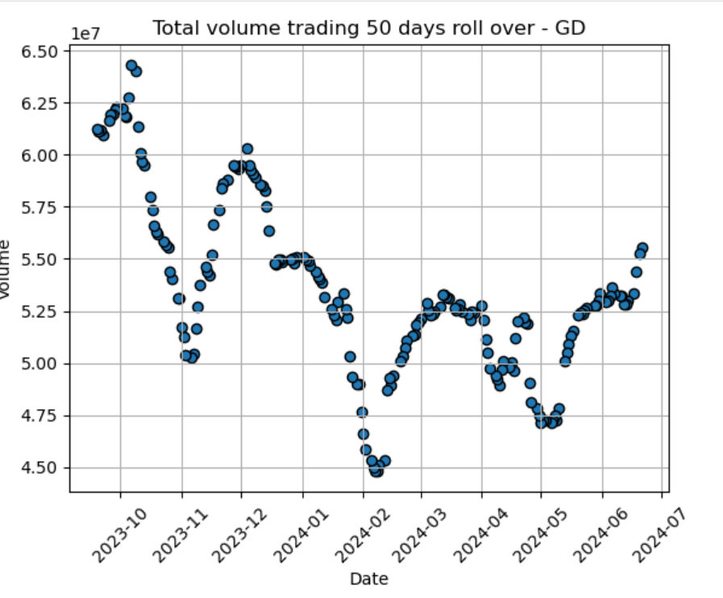
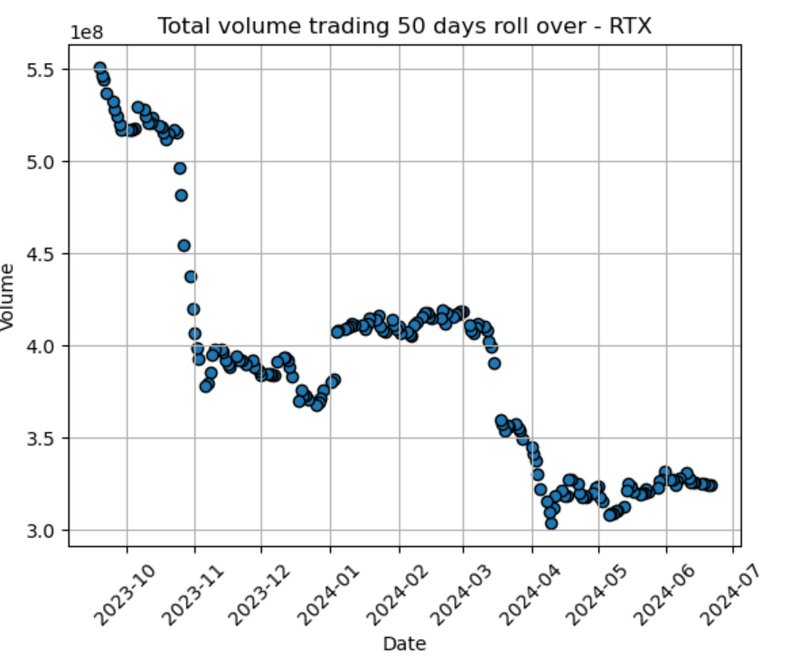
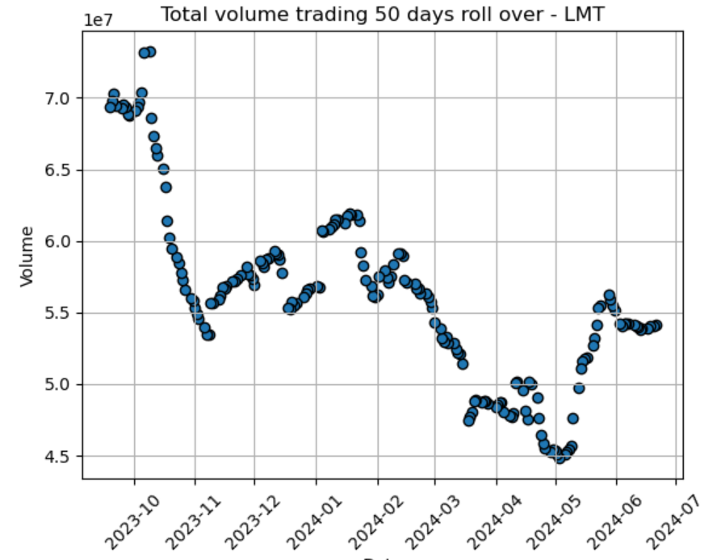
Total Volume trading

Slide 5
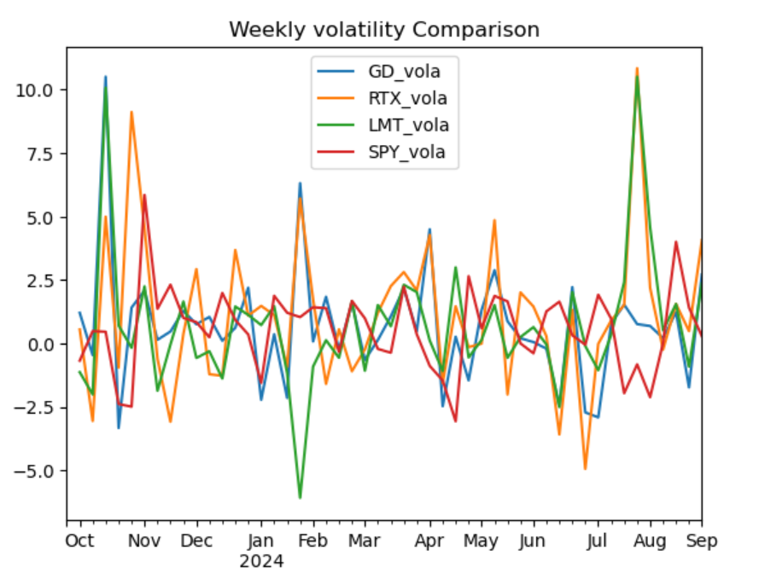
Weekly volatility comparison

Slide 6
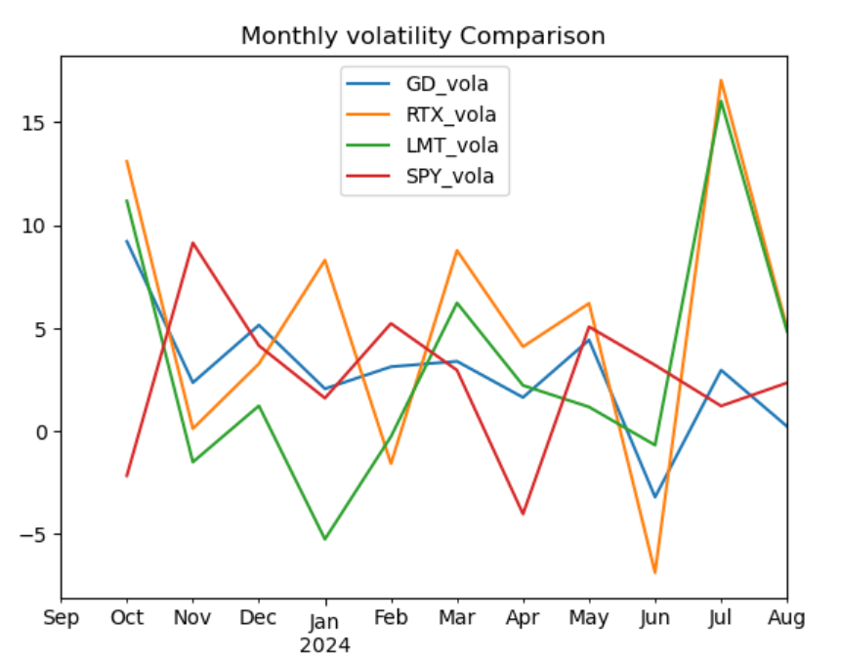
monthly volatility comparison

Slide 7
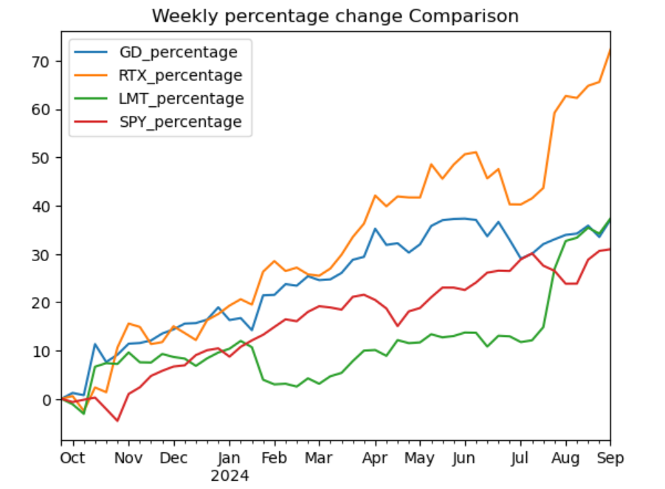
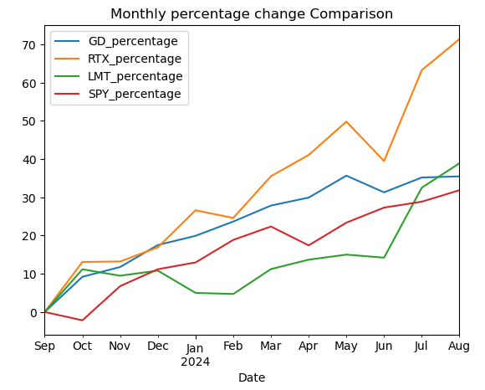
Rate of change (roc)

Slide 8
CONCLUSION
We recommend to invest in RTX(Raytheon),the company has the highest ROC over a year, the stock volume has been trading at 10 times more than direct competitors.
Key Contracts:
Javelin Joint Venture $1.3b
$478m Patriot GETM-T missile
$1.2b to provide additional Patriot air can missile defense to Germany

